Slide 1

Name: Debasmita Jana
debasmitajana0@gmail.com
Organization: DGT
College name: RCC Institute of Information Technology
State: West Bengal
Domain: Data Analytics
S/E date: 12.06.2023 - 24.07.2023

Slide 2
Project Title: Analysis of Superstore Dataset
The goal of this project is to analyze the Superstore dataset to gain insights into sales trends, customer behavior, and operational efficiency. The dataset contains information about various aspects of the store's operations, including sales, customer demographics, product categories, and geographical regions. By conducting a comprehensive analysis, we aim to identify opportunities for improvement and make data-driven recommendations to optimize store performance.
Data Collection and Preprocessing: Collect , preprocess the Superstore dataset.
Sales Analysis: Analyze sales metrics, trends, and factors influencing sales fluctuations.
Customer Behavior Analysis: Study customer demographics, preferences, and segmentation
Exploratory Data Analysis : Perform exploratory analysis, including data distribution, outliers,visualizations.
Operational Efficiency Analysis: Evaluate operational efficiency, identify bottlenecks, and optimize resource allocation.
Conclusion and Next Steps: Summarize findings, advanced analysis, predictive modeling, integration of external data sources.

Slide 3
AGENDA:
S.no. | Topics Name | Page no
1 | Project Overview | 3-10
2 | Data set Dataset loading About the Dataset | 11-12
3 | Some Statistical Information | 13
4 | Exploratory Data Analysis (EDA) What are the top selling products in the superstore? What are the top profit products in the superstore? What is the total Sales and Profit by region? Select top 5 cities by profit and Sort the data by profit in descending order | 14-21
5 | The Best Sales Plotting Conclusion | 22-23

Slide 4
Project Overview
The dataset used in this analysis contains information about sales transactions, customers, products, and geographical locations. The analysis involves using Power BI, a data visualization and reporting tool, to create interactive dashboards and reports that provide insights into the sales performance of Superstore
Purpose: to gain insights into sales trends, customer behavior, and operational efficiency in order to optimize store performance and make data-driven recommendations for improvement
.
Scope: data cleaning, exploratory data analysis, sales analysis, customer behavior analysis
Objective:
Identify sales trends, such as seasonal patterns and fluctuations, to optimize inventory management
Understand customer behavior by analyzing demographics, preferences, and purchase patterns
Improve operational efficiency by identifying bottlenecks, streamlining processes,optimizing resource allocation
Provide data-driven recommendations to optimize store performance,

Slide 5
WHO ARE THE END USERS
Target Audience or End Users:
Store Managers: They require insights on sales performance, customer behavior, and operational efficiency
Marketing Managers: They need information on customer demographics, preferences, and buying patterns
Characteristics and Needs:
comprehensive data analysis, visualizations, and actionable recommendations to identify areas for improvement, enhance profitability, and streamline operations.
Benefits from the Solution:
optimized inventory management, improved sales forecasting, and streamlined operations, leading to increased profitability
benefit from targeted marketing campaigns, enhanced customer engagement, and improved customer retention, resulting in increased sales and brand loyalty.

Slide 6
Solution and its value proposition
The solution for the "Analysis of Superstore dataset" project involves conducting a comprehensive analysis of the Superstore dataset to gain insights into sales trends, customer behavior, and operational efficiency. This analysis will be carried out using various statistical and data mining techniques, as well as advanced visualization tools.
Value Proposition:
Data-Driven Decision Making: . can make informed decisions based on comprehensive analysis, leading to improved store performance, optimized operations, and targeted marketing strategies.
Enhanced Profitability: Our analysis helps identify opportunities for increasing sales, improving inventory management, and reducing costs, ultimately leading to enhanced profitability for the Superstore.
Customer Insights and Personalized Marketing: to develop personalized marketing campaigns, tailor promotions, and enhance customer engagement, resulting in increased customer satisfaction, retention, and ultimately, higher sales.
Competitive Advantage: Leveraging the power of data analysis, our solution provides the Superstore

Slide 7
Modelling
techniques, methodologies, and frameworks were applied
Exploratory Data Analysis (EDA):
included data visualization through charts, graphs, and plots to understand the distribution of variables, identify outliers, and detect patterns or relationships between different variables.
Statistical Analysis:
These techniques helped in understanding the impact of various factors on sales, customer behavior, and operational efficiency.
Customer Segmentation:
applied o categorize customers based on their attributes and buying behavior. This allowed for the identification of distinct customer groups with specific needs and preferences, enabling targeted marketing strategies.
Data Visualization:
Advanced data visualization techniques using tools like Python libraries (e.g., Matplotlib, Seaborn) were used to create visually appealing and informative charts, graphs, and dashboards. These visualizations facilitated the effective communication of analysis results and provided a clear representation of key findings.

Slide 8
Customize the project and make it my own
Advanced Visualization with Matplotlib and Seaborn:
solution stands out by utilizing the powerful libraries Matplotlib and Seaborn. These libraries offer extensive customization options, allowing for the creation of visually appealing and insightful charts, graphs, and plots.
Interactive Dashboards:
dashboards allow stakeholders to dynamically explore and interact with the analyzed data, enabling them to drill down into specific details, apply filters, and visualize different dimensions,dashboards enhances engagement, facilitates deeper insights, and empowers users
Descriptive Analytics:
to summarize and present key information about sales trends, customer behavior, operational performance within the Superstore dataset. This includes calculating summary statistics, generating frequency distributions, identifying important patterns or trends.
Forecasting and Trend Analysis:
Apply forecasting methods and trend analysis to predict future sales trends and demand patterns.

Slide 9
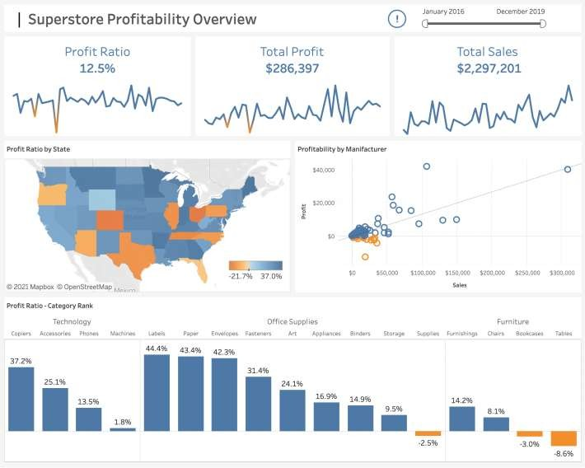
Results:

Slide 10
LINKS:
https://colab.research.google.com/drive/1gBfkrqdJTLbou7RwWg1vV1iqcBd6p3as?usp=sharing
Research Paper:
Chakraborty, M. (2020). Sales Analysis of Superstore using Power BI. Kaggle.
https://www.kaggle.com/moumoyesh/sales-analysis-of-superstore-using-power-bi
Microsoft. (n.d.). Analyse and visualize Superstore data in Power BI. https://powerbi.microsoft.com/en- us/tutorials/analyze-and-visualize-superstore-data/
Vignesh, S. (2021). Sales Analysis of Superstore dataset using Power BI. Towards Data Science. https://towardsdatascience.com/sales-analysis-of-superstore-dataset-using-power-bi-1432f74fa62e
Pranav, B. (2021). Sales Analysis of Superstore Data using Power BI. Analytics Vidhya.
https://www.analyticsvidhya.com/blog/2021/04/sales-analysis-of-superstore-data-using-power-bi/
Microsoft. (n.d.). Analyse and visualize Superstore data in Power BI. https://powerbi.microsoft.com/en- us/tutorials/analyze-and-visualize-superstore-data/

Slide 11
DATA SET:
. Data set URL:
https://www.kaggle.com/datasets/vivek468/superstore-dataset-final
About the dataset:
The dataset provides information about the sales and profit from a
supermarket.
Dataset details:
Size | 563kb
Number of columns | 21
Number of Rows | 9994
Original file format | Csv
Column e',
'Customer ID', 'Customer Name', 'Segment', 'Country', 'City', 'State', 'Postal Code', 'Region', 'Product ID', 'Category', 'Sub-Category', 'Product Name', 'Sales', 'Quantity', 'Discount', 'Profit']

Slide 12
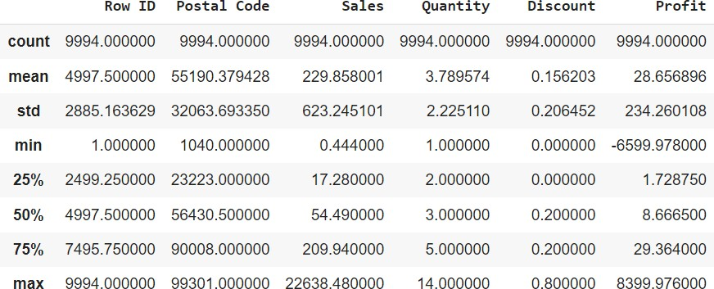
some statistical information:
Understanding the distribution of the data: The mean, min, max, and other metrics provide a quick overview of the distribution of the data.
Outlier detection: The min, 25%, 75%, and max values can help identify outliers in
the data.
Data normalization: The mean and std values can be used to normalize the data. Feature scaling: The min, max, and other values can be used to scale the features to a suitable range.
df.describe()

Slide 13
# Step-1: Importing the dataset
# Importing libraries import pandas as pd import numpy as np
df = pd.read_csv("/content/drive/MyDrive/IBM_Project/Superstoredataset.csv", encoding='cp1252')
df
checking data type and missing values:
df.info()
Read the columns or Features of the dataset:
df.columns
Null Value check:
df.isna().sum()
Read the Duplicate value:
df.duplicated().sum()

Slide 14
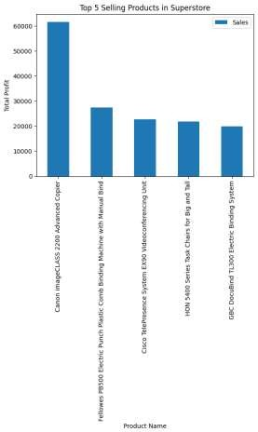
# Step-2: Exploratory Data Analysis – EDA:
What are the top selling products in the superstore?
# Group the data by Product Name and sum up the sales by product product_group = df.groupby(["Product Name"]).sum()["Sales"] product_group.head()
top_5_selling_products.plot(kind="bar")
# Add a title to the plot
plt.title("Top 5 Selling Products in Superstore")
# Add labels to the x and y axes plt.xlabel("Product Name") plt.ylabel("Total Profit")
# Show the plot plt.show()

Slide 15
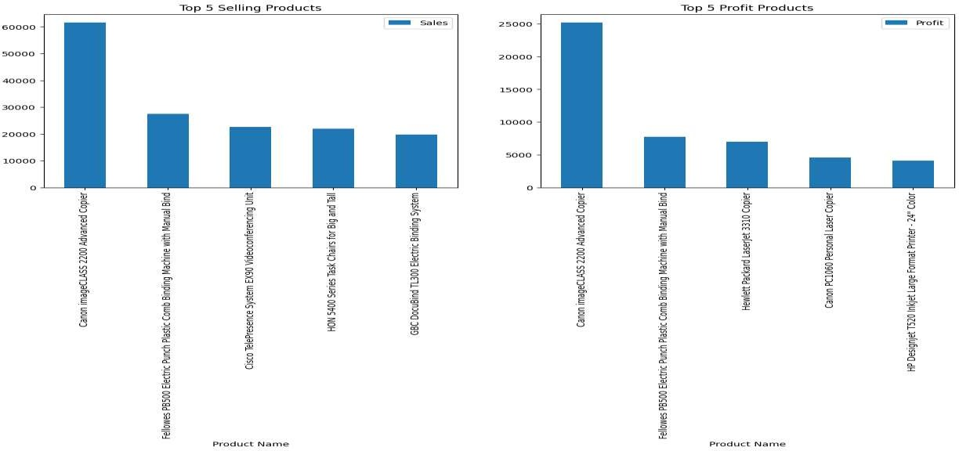
Are the top-selling products the most profitable?

Slide 16
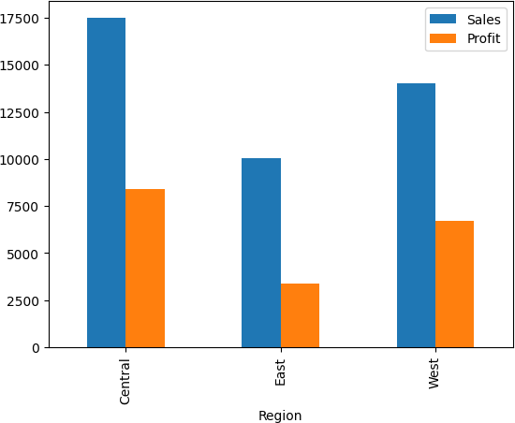
What is the total Sales and Profit by region?
# Filter the data to only include the Canon imageCLASS 2200 Advanced Copier
product = df[df["Product Name"] == "Canon imageCLASS 2200 Advanced Copier"
# Group the data by Region
region_group = product.groupby(["Region"]).mean()[["Sales", "Profit"]]
# Ploting region_group.plot(kind="bar")
plt.show()

Slide 17
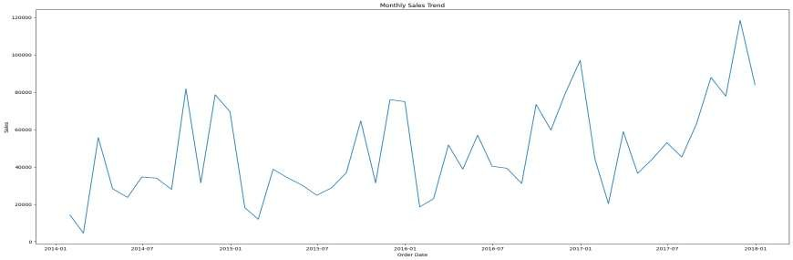
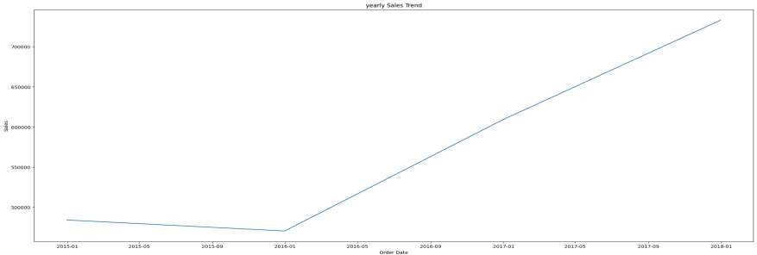
What is the sales trend over time (monthly, yearly)?

Slide 18
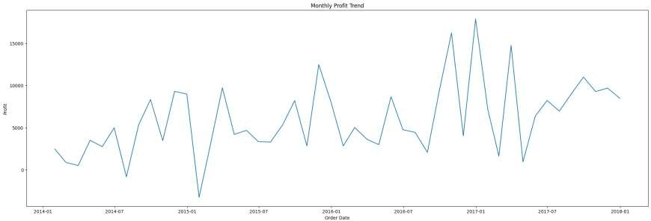
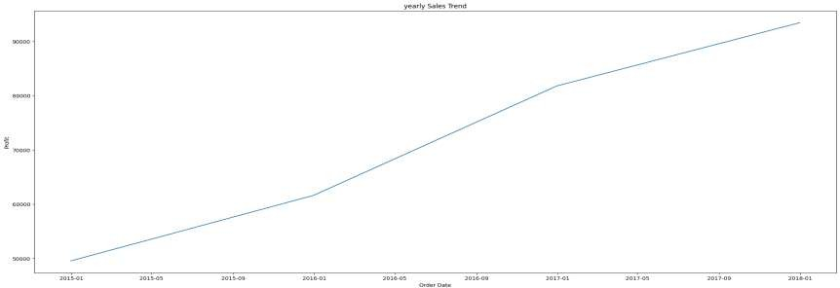
Profit over time:

Slide 19
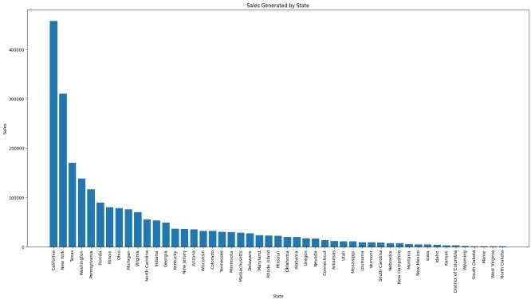
Sales Generated by Statewise:
state_sales = df_places.groupby(['State'], as_index=False).sum() state_sales.sort_values(by='Sales', ascending=False, inplace=True)
plt.figure(figsize=(22,10))
plt.bar(state_sales['State'], state_sales['Sales'], align='center',) plt.xlabel("State")
plt.ylabel("Sales")
plt.title("Sales Generated by State")
plt.xticks(rotation=90)
plt.show() state_sales

Slide 20
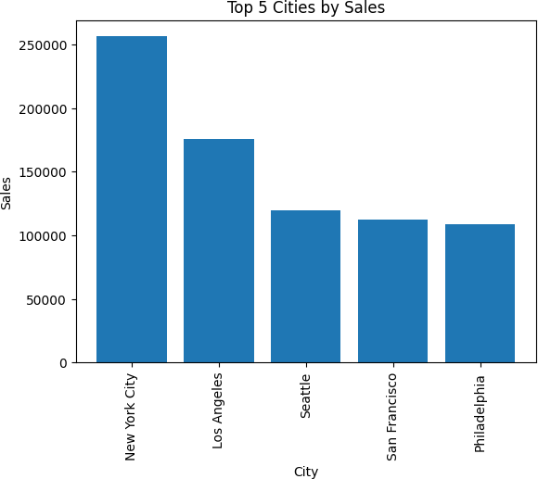
Select top 5 cities by sales and Sort the data by Sales in descending order:
city_sales = df_places.groupby('City', as_index=False).sum() # Sort the data by Sales in descending order
city_sales.sort_values(by='Sales', ascending=False, inplace=True) # Select the top 5 cities
top_5_cities_sales = city_sales.head()
plt.bar(top_5_cities_sales['City'], top_5_cities_sales['Sales'], align='center')
plt.xlabel("City") plt.ylabel("Sales") plt.title("Top 5 Cities by Sales") plt.xticks(rotation=90)
plt.show() top_5_cities_sales

Slide 21
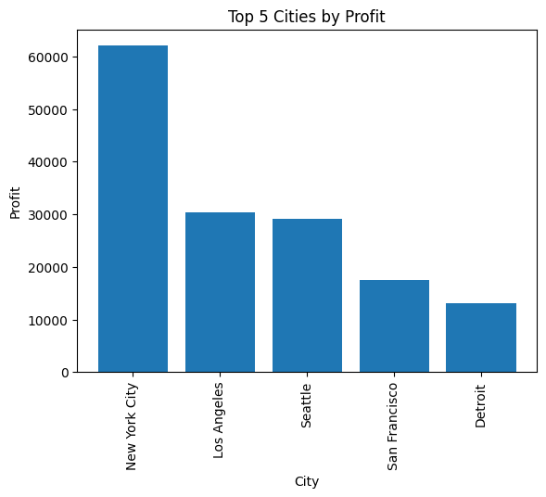
Select top 5 cities by profit and Sort the data by profit in descending order:
city_profit = df_places.groupby('City', as_index=False).sum()
# Sort the data by Sales in descending order
city_profit.sort_values(by='Profit', ascending=False, inplace=True)
# Select the top 5 cities top_5_cities_profit =city_profit.head()
plt.bar(top_5_cities_profit['City'], top_5_cities_profit['Profit'], align='center')
plt.xlabel("City") plt.ylabel("Profit") plt.title("Top 5 Cities by Profit") plt.xticks(rotation=90)
plt.show() top_5_cities_profit

Slide 22
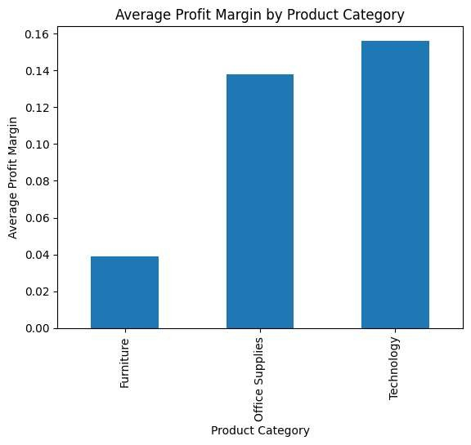
The best sales:
# Group the data by product category and calculate the average profit for each category avg_profit_margin_by_category = df.groupby('Category')['Profit'].sum() print(avg_profit_margin_by_category)
df['Profit Margin'] = df['Profit'] / df['Sales']
# Group the data by product category and calculate the average profit margin for each
category
avg_profit_margin_by_category = df.groupby('Category')['Profit Margin'].mean()
# Plot the average profit margin for each category as a bar chart
avg_profit_margin_by_category.plot(kind='bar')
# Add a title and labels to the chart
plt.title("Average Profit Margin by Product Category") plt.xlabel("Product Category")
plt.ylabel("Average Profit Margin")
plt.show()

Slide 23
CONCLUSION:
Sales Trends
Customer Segmentation
Predictive Insights
Enhanced Profitability
Improved Decision Making
Customer Satisfaction and Retention

Slide 24
THANK YOU!

